Slide 1

AWS Analytics Services
Lesson 06: AWS Analytics services
Notes:
Add instructor notes here.

Slide 2
Lesson Objectives
In this lesson, you will learn:
Amazon Elastic Map Reduce
Amazon Red shift
AWS Data Pipeline
Amazon CloudSearch
Notes:
Amazon Elastic Map Reduce
Amazon Red shift
AWS Data Pipeline
Amazon CloudSearch
This lesson is to give an Introduction on Java Server Pages

Slide 3
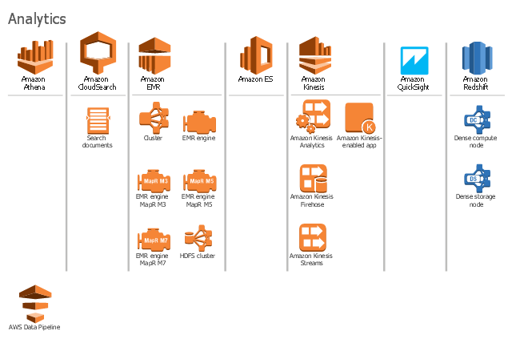

6.1: Amazon EMR AWS Analytics

Slide 4

8.1: Amazon EMR Amazon Analytics Services
AWS offers a comprehensive set of services to handle every step of the analytics process chain, that include
data warehousing
business intelligence,
batch processing,
stream processing,
machine learning and data workflow orchestration
These services are powerful, flexible, and yet simple to use, enabling organizations to put their raw data to work quickly and easily.
Notes:
AWS offers a comprehensive set of services to handle every step of the analytics process chain including data warehousing, business intelligence, batch processing, stream processing, machine learning, and data workflow orchestration. These services are powerful, flexible, and yet simple to use, enabling organizations to put their raw data to work quickly and easily.

Slide 5
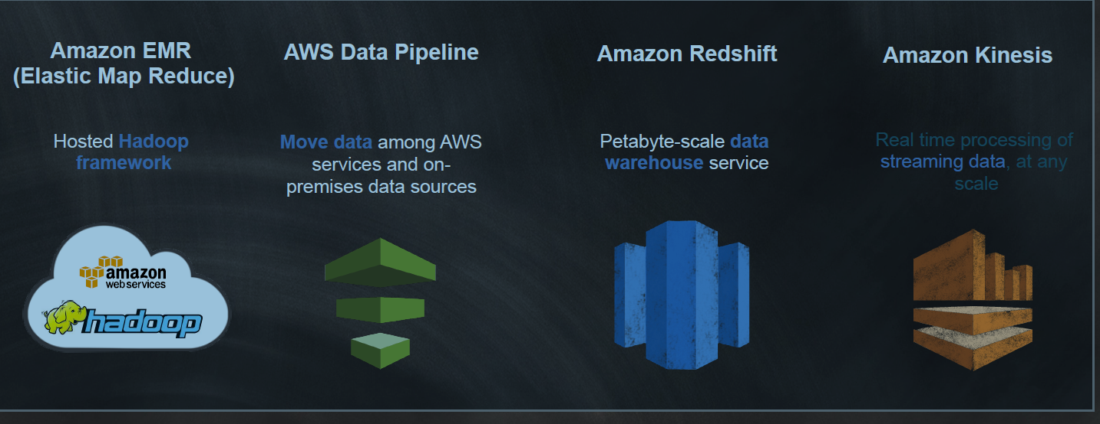
6.1: Amazon EMR AWS Analytics Services

Slide 6
6.1: Amazon EMR Amazon EMR(Elastic Map Reduce)
Product Type --- Hadoop
Amazon EMR simplifies big data processing, providing a managed Hadoop framework that makes it easy, fast, and cost-effective for you to distribute and process vast amounts of your data across dynamically scalable Amazon EC2 instances.
One can also run other popular distributed frameworks such as Apache Spark, Hbase in Amazon EMR.
interact with data in other AWS data stores such as
Amazon S3 and Amazon DynamoDB.
Notes:
Provides a managed Hadoop framework to process vast amounts of data quickly and cost-effectively. Run open source frameworks such as Apache Spark, HBase, Presto, and Flink.

Slide 7
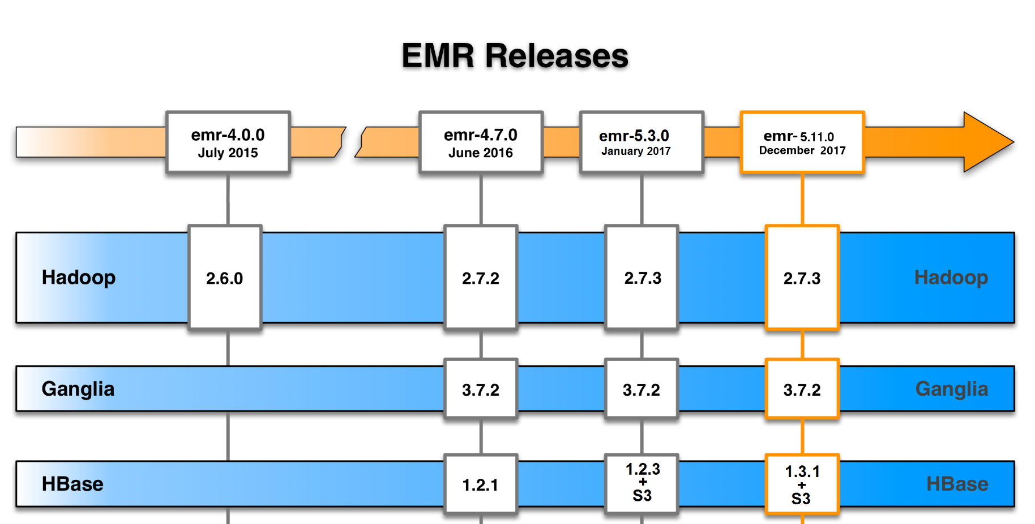
6.1: Amazon EMR Amazon EMR – Releasing History
Notes:
Provides a managed Hadoop framework to process vast amounts of data quickly and cost-effectively. Run open source frameworks such as Apache Spark, HBase, Presto, and Flink.

Slide 8
6.1: Amazon EMR Amazon EMR - Benefits
Few benefits are listed below
Easy to use
Low cost
Elastic
Reliable
Secure
Flexible
Notes:
Easy to use :-- Amazon EMR cluster in minutes. It takes care of cluster setup, Hadoop configuration, or cluster tuning
Low cost :-- Pay a per-second rate for every second used, with a one-minute minimum charge.
Elastic :- With Amazon EMR, you can provision one, hundreds, or thousands of compute instances to process data at any scale.
Reliable:--- One can spend less time tuning and monitoring your cluster.
Secure :--- Amazon EMR automatically configures Amazon EC2 firewall settings that control network access to instances, and you can launch clusters in an Amazon Virtual Private Cloud .
Flexible

Slide 9
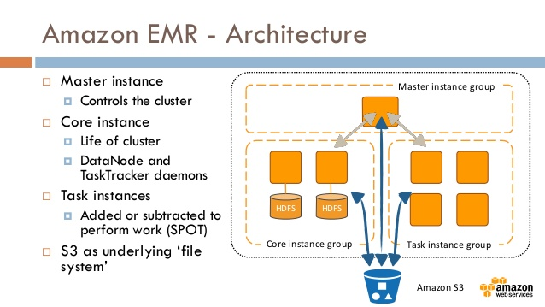
6.1: Amazon VPC Amazon EMR

Slide 10
6.2: Amazon Redshift Amazon Redshift
Product Type --- Data Warehouse
It is a fast, fully managed data warehouse which makes it simple and cost-effective to analyze all your data using standard SQL and your existing Business Intelligence (BI) tools.
It allows to run complex analytic queries against petabytes of structured data, using sophisticated query optimization, columnar storage on high-performance local disks, and massively parallel query execution.
Amazon Redshift also includes Redshift Spectrum, allowing you to directly run SQL queries against exabytes of unstructured data in Amazon S3
Notes:
Fast, fully managed, petabyte-scale data warehouse that makes it simple and cost-effective to analyze all of your data using your existing business intelligence tools.

Slide 11
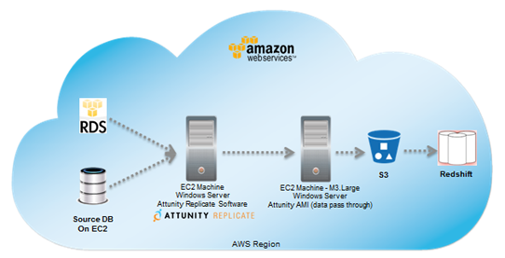
6.2: Amazon Redshift Amazon Redshift
Notes:
Fast, fully managed, petabyte-scale data warehouse that makes it simple and cost-effective to analyze all of your data using your existing business intelligence tools.

Slide 12
8..2: Amazon Redshift AWS Data Pipeline
Product Type --- Data Workflow Orchestration.
It is a type of web service which helps reliably process and move data between different AWS compute and storage services, as well as on-premise data sources, at specified intervals.
With AWS Data Pipeline, one can regularly access the data where it’s stored, transform and process it at scale, and efficiently transfer the results to AWS services
such as Amazon S3, Amazon RDS,
Amazon DynamoDB, and Amazon EMR.

Slide 13
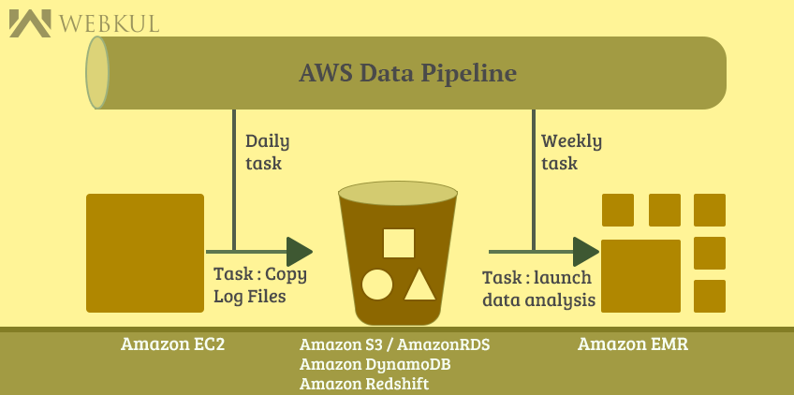
6.3: AWS Data pipeline AWS Data Pipeline

Slide 14
6.3: AWS Data pipeline AWS Data Pipeline - Benefits
Reliable : ---
If failures occur in any one activity logic or data sources, AWS Data Pipeline automatically retries the activity. If the failure persists, AWS Data Pipeline sends you failure notifications via Amazon Simple Notification Service (Amazon SNS).
Easy to use :---
One can check for the existence of an Amazon S3 file by simply providing the name of the Amazon S3 bucket and the path of the file that you want to check for, and AWS Data Pipeline does the rest.
Flexible:--
One can configure an AWS Data Pipeline to take actions like run Amazon EMR jobs, execute SQL queries directly against databases, or execute custom applications running on Amazon EC2 or in your own datacenter.

Slide 15
6.3: AWS Data pipeline AWS Data Pipeline - Benefits
Scalable :-
It makes it equally easy to dispatch work to one machine or many, in serial or parallel
Low Cost :-
AWS Data Pipeline is inexpensive to use
Transparent :--
Full execution logs are automatically delivered to Amazon S3, giving you a persistent, detailed record of what has happened in your pipeline.

Slide 16
6.4: Amazon CloudSearch Amazon CloudSearch
It is a fully managed search service in the cloud which makes it easy to setup , operate and scale a search solution for website and application
It is fully-managed , full-featured search service
Automatically scales for data and traffic
It handled both structured and unstructured data
Up and running in less than 1 hour

Slide 17
6.4: Amazon CloudSearch Amazon CloudSearch - Benefits
The benefits of CloudSearch
Simple
Scalable
Reliable:--
Secure:--
Notes:
Simple : ---
One can configure and manage an Amazon CloudSearch domain through the AWS Management Console, AWS CLI, and AWS SDKs.
Scalable:---
As your data or query volume changes, Amazon CloudSearch can scale your search domain's resources up or down as needed.
Reliable:--
As your data or query volume changes, Amazon CloudSearch can scale your search domain's resources up or down as needed.
Secure:--
Amazon CloudSearch uses strong cryptographic methods
to authenticate users and prevent unauthorized access
to your domains.

Slide 18
Summary
In this lesson, you have learnt:
Amazon Elastic Map Reduce
Amazon Red shift
AWS Data Pipeline
Amazon CloudSearch

Slide 19
Review – Questions
Question 1: ___________ is a fast, fully managed data warehouse which makes it simple and cost-effective to analyze all your data using standard SQL and your existing Business Intelligence (BI) tools.
Question 2 : _________ simplifies big data processing, providing a managed Hadoop framework.
Notes:
Answers for the Review Questions:
Answer 1: Amazon Redshift
Answer 2: Amazon EMR

Slide 20
Review – Questions
Question 3: Which of the following is not an Amazon Analytic service?
Option 1 : Amazon EMR
Option 2 : Amazon Route 53
Option 3 : AWS Data Pipeline
Option 4 : Amazon Cloudsearch
Notes:
Answers for the Review Questions:
Answer 3: Option 2

